Slide 1

Notes:
Aim is just to introduce them to the lab staff and get them comfortable talking in the space
Why are they here? What brought them here?
What is digital humanities for each of us? What was our own particular path into it
welcome to ask me or us questions as we go

Slide 2
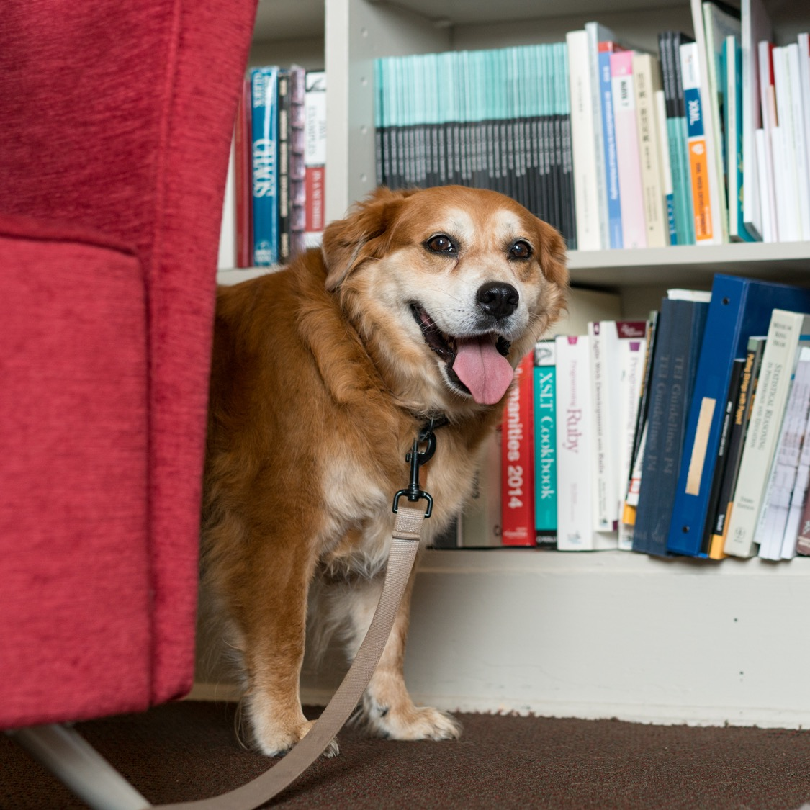
Introductions
Name
Department / what you do
Something else about you
E.g. – something that you’re proud of; worst haircut; dogs you have known

Slide 3
Spaces and Expectations
We'll be online for the fall; will re-evaluate later for spring.
Make sure you have good Slack notifications set and engage if you can.
Up to date info here - praxis.scholarslab.org/curriculum/
Mostly set, but things get shifted around
If something is TBD but you need to know do reach out
10 hours a week / 3 hours in session together
Mondays from 1-2 and Wednesdays from 1-3
Office Hours info will be pinned in slack
Note on working together
Accountable to each other
First and foremost, kindness and generosity
Notes:
Much of the ten hours is going to be taken up with

Slide 4
Anti-Attendance Policy / Policy of Care
The world is a mess – take care of yourself, yours, and each other.
That’s our anti-attendance policy.
It’s fine if you have to miss.
As a courtesy, let us know if you can’t make it.
We’re accountable to each other and can address things if presence becomes a problem, but lead with care and kindness first.

Slide 5
Financial Logistics
If you get paid, let me know
If you think you should get paid but haven't, let me know
If you so much as sense an ill wind about finances, let me know
Better to be redundant than to be delayed
A note on the GSAS portions of your fellowship
Let me know privately after session?
Notes:
We don't hear when things go wrong. We also don't hear when they go right. Let us know about everything.

Slide 6
phdplus.virginia.edu
Notes:
Explain program and pass out handbills

Slide 7
Other Scheduling Things
Be thinking about ways to maintain a community – details forthcoming
Info about office hours will be pinned on slack
DH Fellows colloquium series – dates forthcoming
A few things here and there on the curriculum page
Come to our events if you're able!
Notes:
We don't hear when things go wrong. We also don't hear when they go right. Let us know about everything.

Slide 8
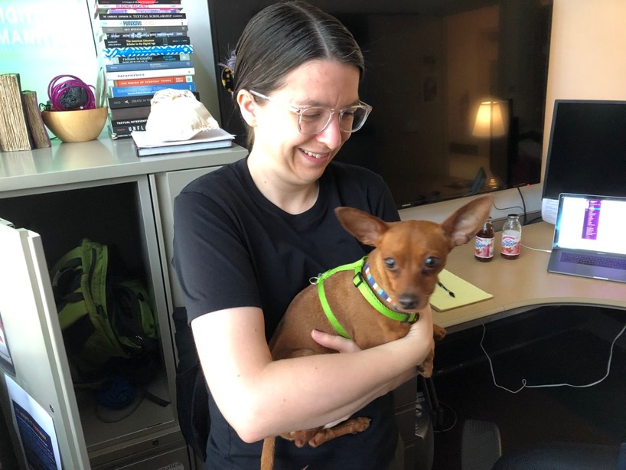
Code Camp
Technical training is its own track
Not to separate hacking from yacking, but to make sure both get time
Once per week
Allows us to go further

Slide 9
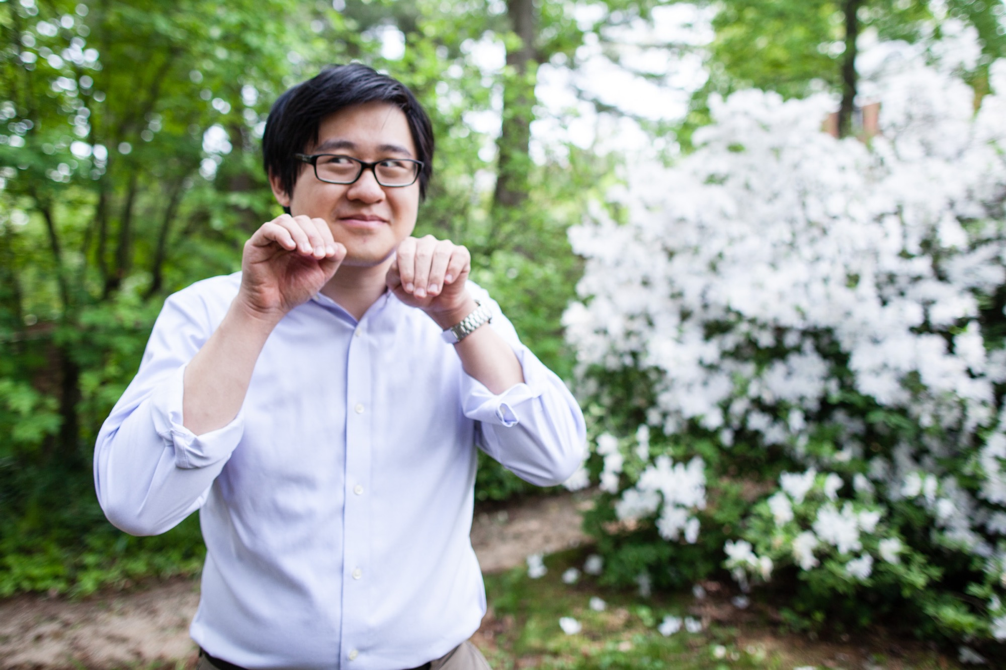
The World According to Shane (Head Shots)
Shane is our awesome photographer
Normally he would give you headshots; happy to do it if the world ever allows.
Reminder to share one if you already have one.

Slide 10
Blogging
Expected to blog semi-regularly
Aim for two each semester; feel free to do more.
For most of you, this will be unpleasant. That's ok!
A blog post can be anything you want it to be!
Check scholarslab.org for ideas
bit.ly/Slab-Blog-Docs
Start drafting now, and we'll work on a time for helping you
Caveat about the internet/cesspool

Slide 11
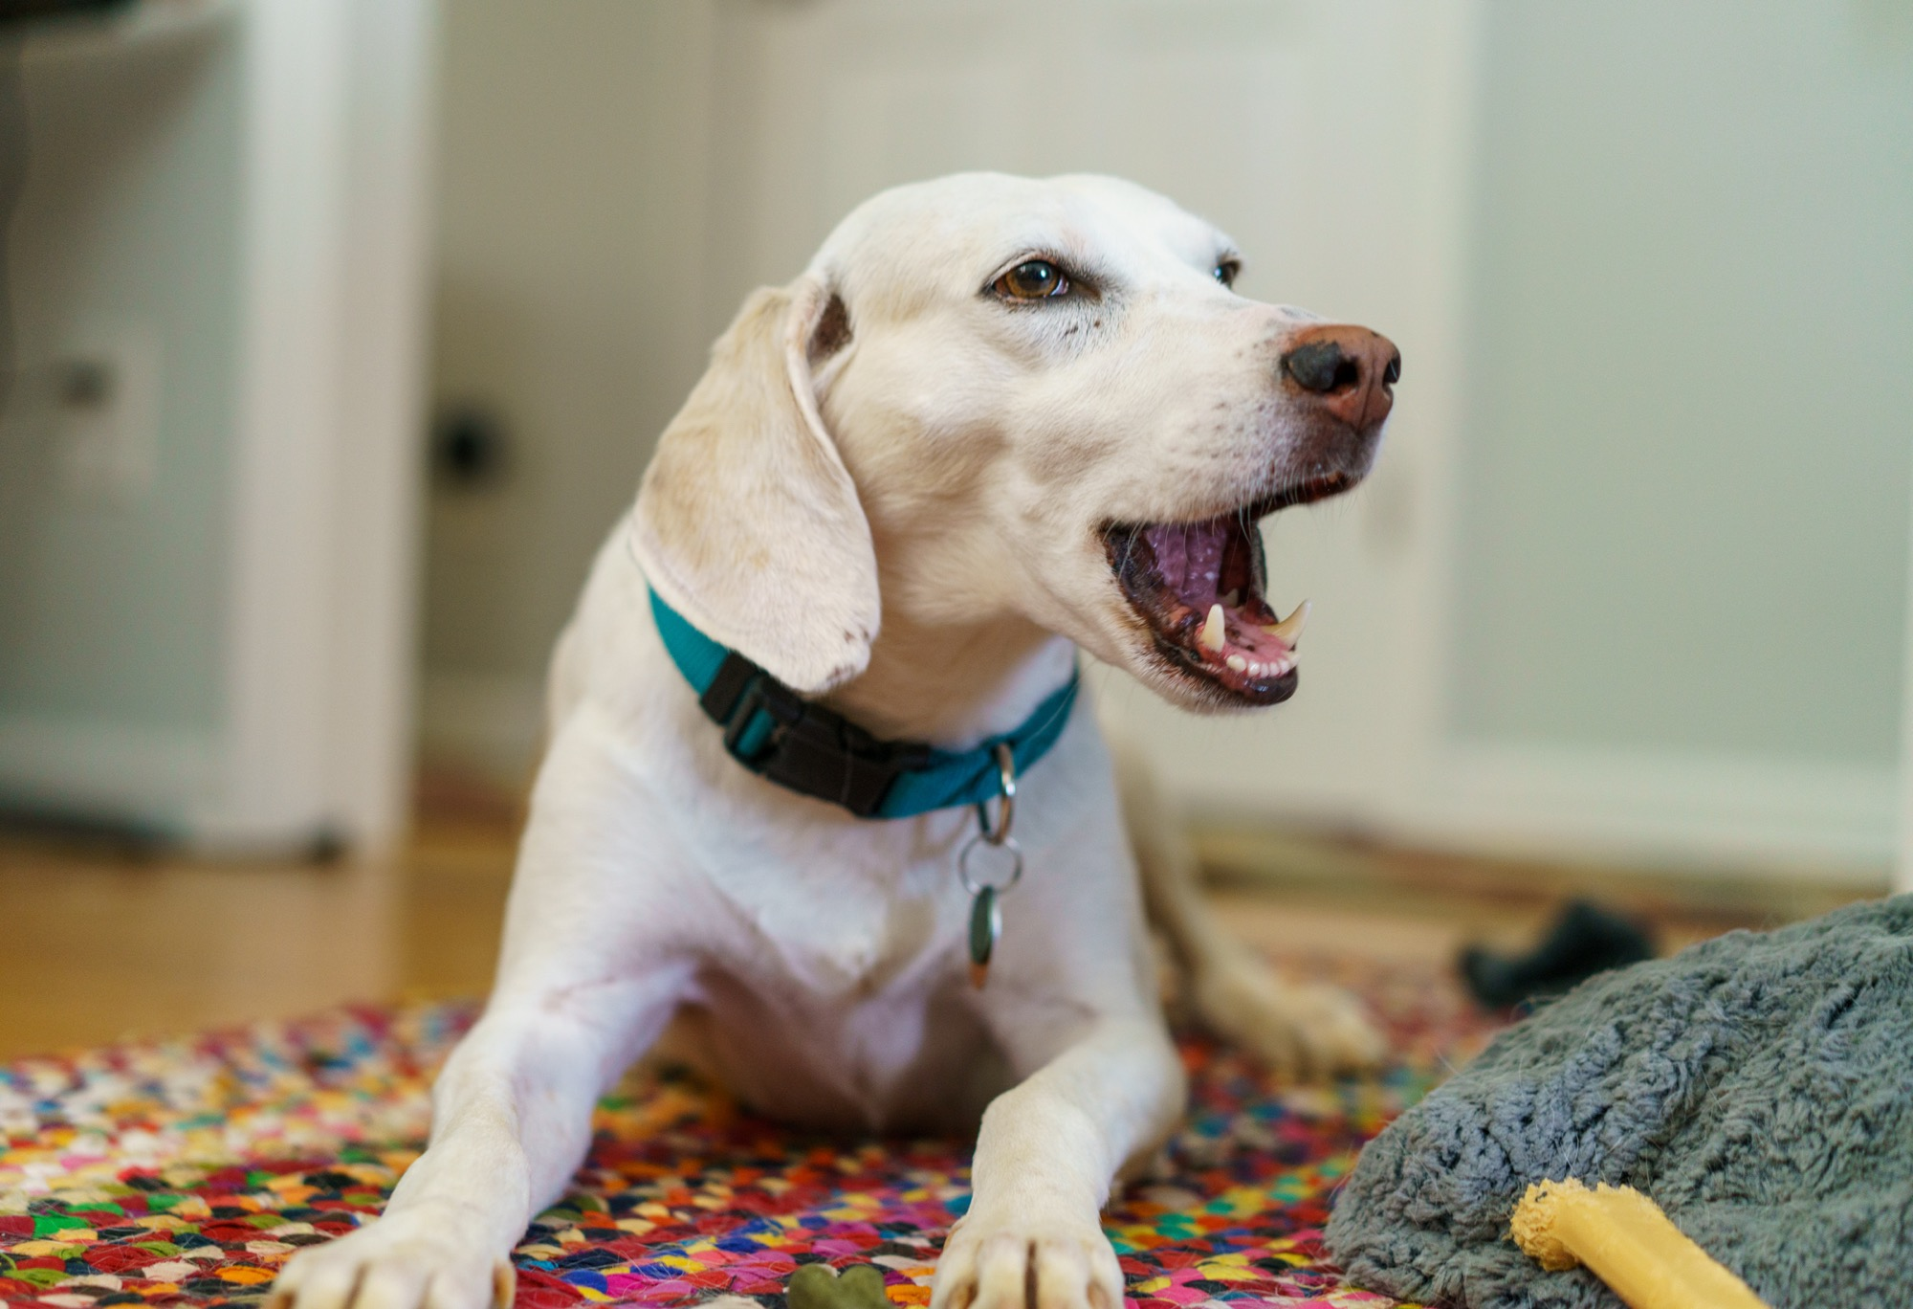

Slide 12
Slack
All invited to the Scholars' Lab slack
Feel free to make your own channels, but also good to be public
Anything we post you're welcome to chime in on
DH Slack - tinyurl.com/DHslack
Amanda thoughts?

Slide 13
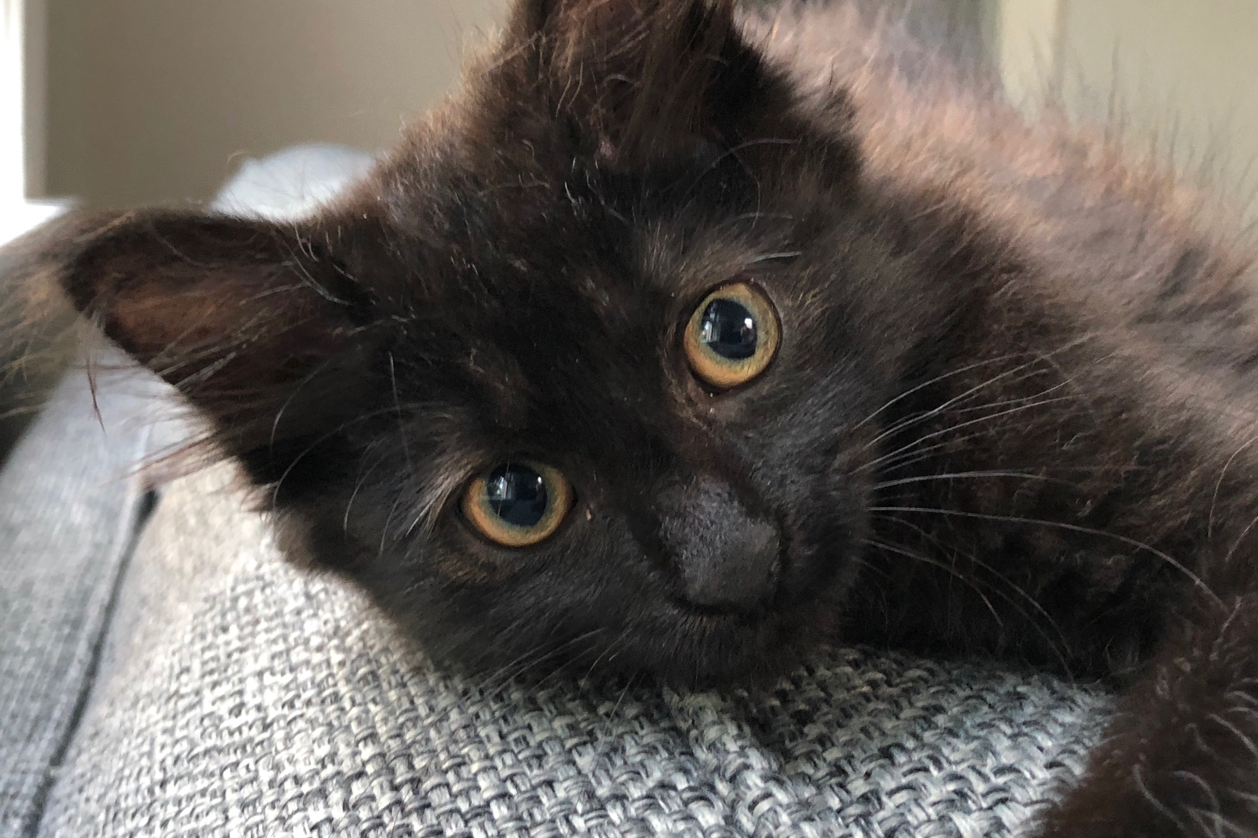

Slide 14
Models we've worked with
Year-long (or more) project where we give the thing, more or less
Prism – prism.scholarslab.org
Ivanhoe – ivanhoe.scholarslab.org
Pros
Intervention often feels more realized
Deep on a single technology
Predictable tech stack (easy to plan)
Cons
Students less invested
Students less empowered
Deep on a single technology
Notes:
The idea behind this is really that you're going to be doing stuff at the same time that you're thinking. Talking at the same time that you're working. Solo but mostly in various iterations of together.

Slide 15
Models we've worked with
Year-long project where we have the students generate the thing
Clockwork – clockwork.scholarslab.org
Dash-Amerikan - dashamerikan.scholarslab.org
UVA Reveal - reveal.scholarslab.org
Pros
Students are empowered
Some students are invested (the talkers)
Deep on a single technology
Cons
Difficult to support
Intervention less realized
Deep on a single technology
Most students still not invested

Slide 16
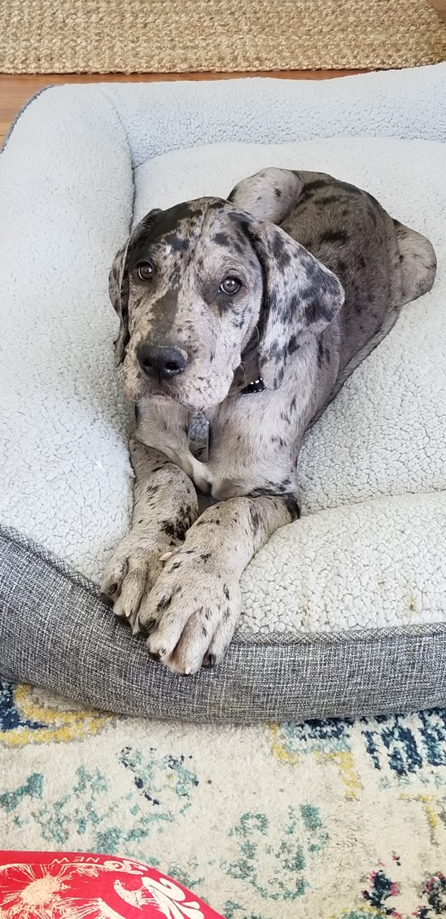
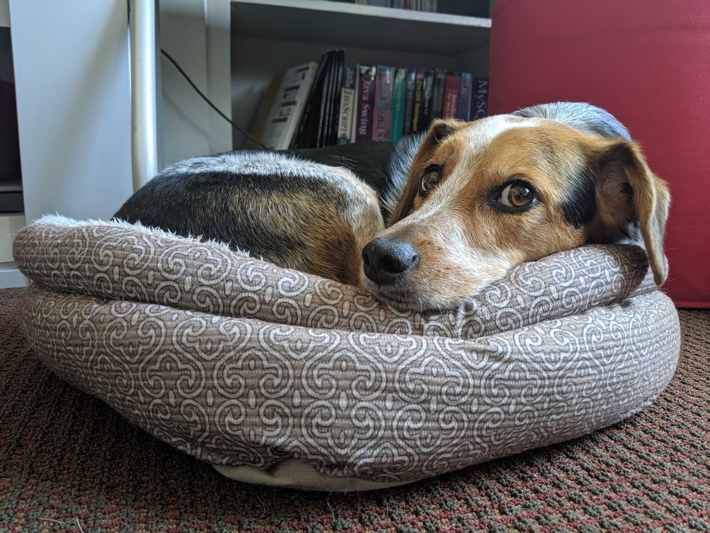

Slide 17
Now
Portfolio of experiences
Some more guided, some more independently grown
Fall
Three assignemnts – Charter, Workshop, Project Proposal
Various shades of group/independent/paired
Spring
Semester-long collaborative project that splits the difference b/w given and shaped
unclosure.scholarslab.org
landandlegacy.scholarslab.org
connection.scholarslab.org

Slide 18
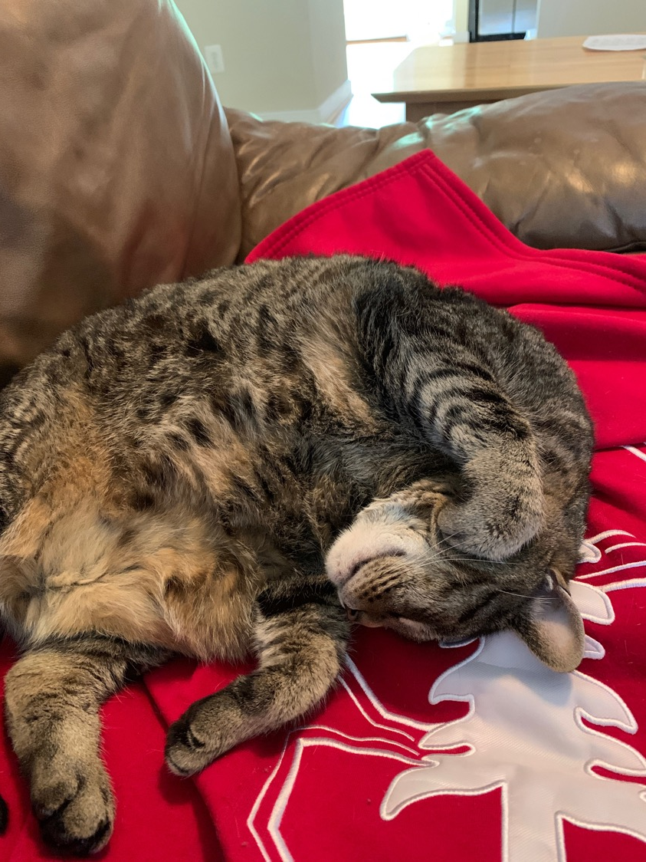
Fall Pt 1 - Charter
Group-authored statement
Values
Goals
Feelings
Ronda will share more
“Due” September 13th

Slide 19
Fall Pt 2 - Workshop
Lightweight workshops, piloted together
Teaching to learn
Opportunities to share them
Also could have an audience here!
DH Roadshow

Slide 20
Fall Pt 3 - Project Proposal
Begin shaping plans for the spring together
Aim for an abstract /description and a project management plan before winter break
Also a chance to make a personal proposal for going further
Something to follow up on this year and in the future
Space to meet

Slide 22
Spring – Project Work
Project – Building on the Code Lab Curriculum
You’re going to be taking a semester-long introduction to coding that Praxis has done for several years. These materials are online, but they have been largely inward-facing. You have a unique perspective on these materials, since you will have just learned from them yourselves! Your project for the year is to take these experiences and materials and develop a public-facing OER project that reframes and/or builds upon the Code Lab curriculum as part of a meditation on how to teach digital methods for humanists. Many possible outcomes that we’ll discuss.
Potentially give your workshops
Public presentation on the group project, usually around reading days

Slide 23
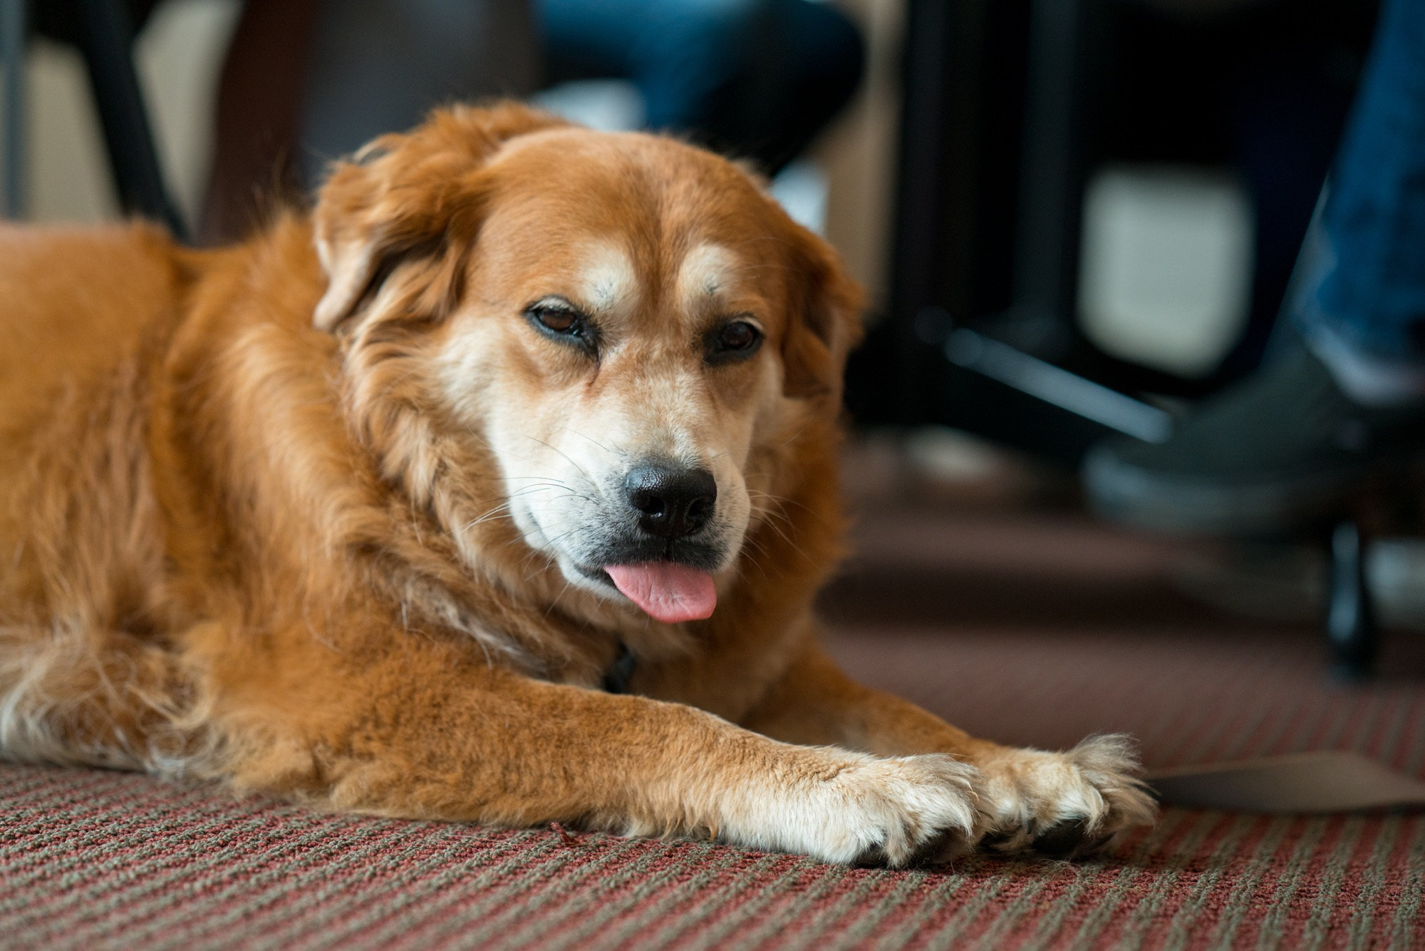

Slide 24
Initial Things
Sign up for a 1:1 with me sometime in the coming weeks
Meet with Shane 1:1 for tech set up
Readings, etc. on the curriculum page
Be present as you’re able

Slide 25
Questions and First Discussions
Notes:
Why are you here?
What do you want out of life? Who are you really?
What are some general reactions to the documents I circulated in advance

